Slide 1
Supporting people living with dementia to be involved in adult safeguarding enquiries
Dr Jeremy Dixon

Slide 2
Context

Slide 3
Social Work Models and Practice - Issues of abuse and neglect
Older adults with dementia are at greater risk of abuse and neglect than those without a diagnosis (Fang and Yan, 2018).
Government statistics show that older adults are more likely to be subject to a safeguarding enquiry (NHS Digital, 2020), with one in 38 adults aged 85 and over having been subject to an enquiry compared to one in every 862 adults aged between 18-64.
Notes:
International statistics show that people living with dementia are more likely to be subject to abuse and neglect than those who are not. Such abuse often goes unnoticed, because dementia may affect a person’s ability to recognise abuse or to report it (Cooney et al, 2006). The number of studies focussing on the abuse of people living with dementia in the UK is still small.
Figures indicate that 1 out of every 38 adults aged 85 was involved in a safeguarding enquiry; a figure 37 times higher than for adults aged 18-64.

Slide 4
The process

Slide 5
The process
Consultations with:
The Margaret Butterworth Forum
Swindon Alzheimer’s Society
Think Local, Act Personal
Yeovil Memory Matters
Input from representatives of:
ADASS
Principal Social Workers’

Slide 6
The guidance

Slide 7
Part 1 – Evidence summary
Previous research focussing on the abuse of people living with dementia in the UK
What research tells us about how adults living with dementia understand risk
Principles for Practice
Human Rights
Applying a strengths-based approach
Considering culture and diversity
Notes:
UK studies, still small. However, it is useful to be aware of the key findings:
UK studies report high amounts of abuse in the community. Study by Cooney (based on self-reports by carers) identified 51% of carers reported chronic verbal aggression, 20% physical abuse and 4% neglect. A later study by Cooper identified self-reports of abuse. The most common form of abuse was verbal abuse at 33% with physical abuse being the least reported at 4%. Studies in care homes have also recorded rates of abuse by self-reports by staff. A small scale study by Cooper (2013) found that 8.3% of carers reported threatening residents, avoiding residents or not giving them enough food. A large scale study focussing on the care home experience for older people found 51% of staff had seen or reported elder abuse in the last 3 months. The highest figures were making a resident wait for care or avoiding residents. There is a connection between the level of need and the level of abuse reported – i.e. those whose behaviours are viewed as challenging are more likely to receive abuse or neglect.
How people understand risk
Research with older adults identifies they are highly aware of the dangers and hazards related to their condition. i.e. financial scams, not turning off the job or risks of driving. However, studies indicate that people living with dementia rarely use the work risk, when thinking or speaking about their experience.
Family carers are highly aware of risk, although carers in most studies noted the need to reduce rather than to eradicate risk.
Earlier studies with staff identify that people wish to balance risks against best interests, although in earlier studies workers appear to be risk-adverse. In more recent studies (Stevenson and Taylor, 2017) staff see the need to engage in positive risk taking. Staff are more likely to do so where they feel supported by their agency.
Principles for Practice
Human Rights – Practice in England should be informed by the Human Rights Act 1998. However, there has also been a focus on the UN Convention of the Rights of People with Disabilities. The document makes reference to FRIEDA principles – Fairness, Respect, Equality, Identity, Dignity, Autonomy.
Strengths-based – Should acknowledge and draw on the resources of the individual. Makes references to LA resources.
Culture and diversity – Consider relationships between gender, sexuality ethnicity; the link between physical and mental illness; social relationships; socio-economic status; effects of migration

Slide 8
Part 1 – Evidence Summary
The Legal and policy context
The Care Act 2014
The Mental Capacity Act 2005
Supported decision-making
Advocacy
Notes:
The Care Act 2014
S. 42 criteria
Empowerment, Prevention, Proportionality, Protection, Partnership, Accountability.
Care Act guidance on primary prevention (community interventions to prevent needs occurring), secondary prevention (early-interventions to prevent a risk arising), tertiary prevention (formal interventions to address need)
Making Safeguarding Personal
The Mental Capacity Act 2005
5 key principles of the Act and best-interests
Supported decision-making
People with to be involved in decisions for as long as possible, but often feel constrained by friends and families.
Supported decision-making frameworks can be used to enhance autonomy. The international disability literature is useful here.
At a practical level, supported decision-making focuses on the environmental demands for decision-making (such as consideration for the procedure in question, the physical space that the person is in and the relationship between the individual and the decision-maker).
It also focuses on the support that is required to enable the person to decide
Advocacy
Identifies the role of Care Act advocates, IMCAs and IMHAs.

Slide 9
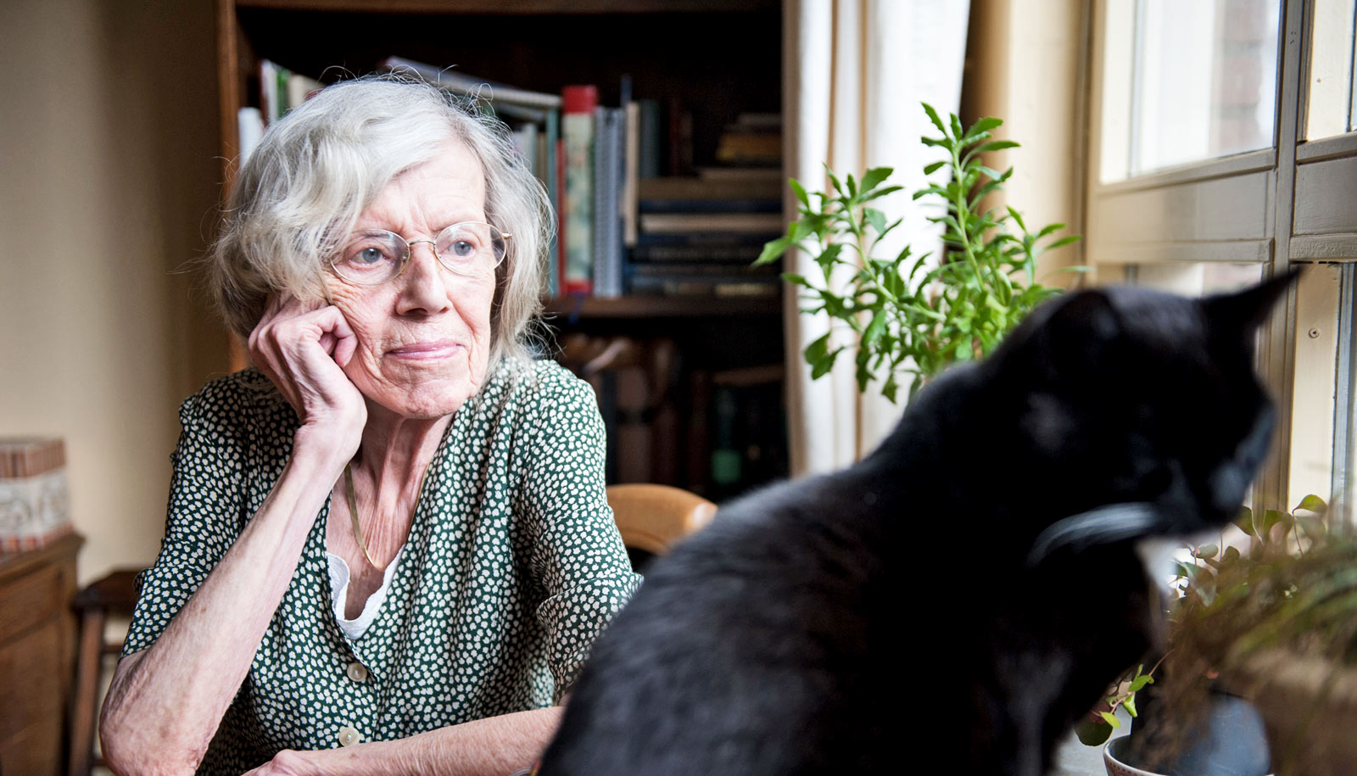
Part 2 – Suggestions for good practice
Providing people with clear information about safeguarding
Providing local information
Think about the person and their environment
Consider the person’s communication needs
Think about what is important to the person
Think about where the conversation is held
Notes:
Providing clear information
Giving excessive information can be challenging for cognitive retention
Levels of awareness about safeguarding remain unclear.
Good practice examples given (County Durham, Doncaster, Cornwall).
Think about the person and their environment
Users identified the need to break down information
Graph to consider – type of dementia, method of communication, times of the day when communication best, hearing impairments, visual impairments, cultural issues, ethnicity sexuality.
[Research indicates that PWD are able to best engage where workers talk to them in a spirit of collaboration, research has indicated that gay people with dementia may hide their identities].
One page profiles (used by Helen Sanderson) can be useful for identifying issues.
Need to consider where the conversation is held [current research indicates this is harder in noisy or cluttered environments]

Slide 10
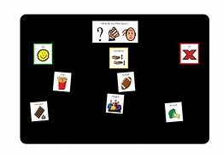
Part 2 – Suggestions for good practice
Building relationships with the person with dementia
Consider advocacy
Use decision-guides
Consider how meetings or discussions are recorded
Review Practice
Notes:
Building relationships
Consultees identified that they found it difficult to communicate with new people [ties in with research evidence which states that people with dementia prefer to be supported by people that they know well]. Therefore, we should try and use friends and family members where they are not implicated in the safeguarding concern.
Consultees said they would value help and support from others. Need to use advocacy where the statutory criteria are met.
Using decision-aids
Consultees identified that they found it hard to concentrate and so need to be given limited options [this is a tension in safeguarding work, as reducing options too much can also limit the person’s legal rights].
Decision aids have been adopted in Canada to help people identify and evaluate options.
Review practice
In line with MSP useful to identify:
Have things changed? How have they changed?
Whether the person has progressed towards their wishes and outcomes.
What has helped reach the outcomes
What could have been done differently.

Slide 11
References
Department of Health & Social Care, 2021. Supporting people living with dementia to be involved in adult safeguarding enquiries. London: Department of Health and Social Care.

