Slide 1
BLAMING LANGUAGE
Juliet Wear, Named Nurse Safeguarding Children & Child Exploitation Lead

Slide 2
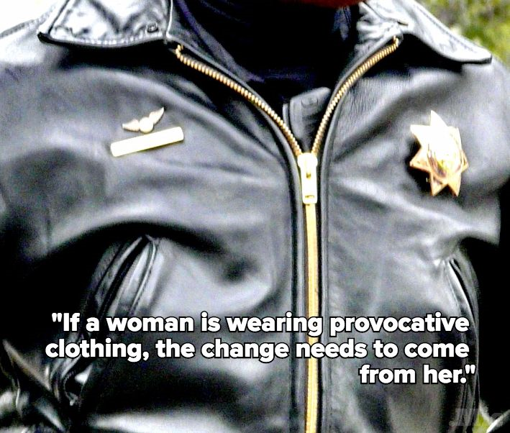
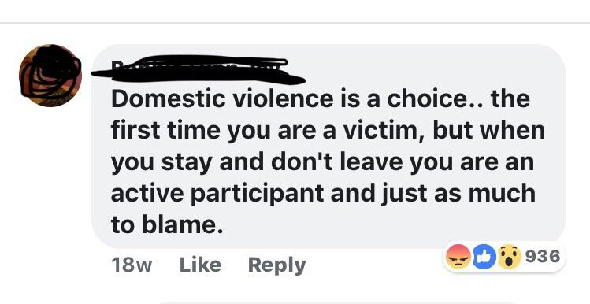
Victim Blaming

Slide 3
Implications of Victim Blaming
Disguises victimhood - We see “troublesome teenagers” instead
Suggests that the child could have done something else
Affects our ability to recognise abuse
What message does the child hear?
“It is their fault & responsibility”
It can be used against them in court by defence lawyers to undermine the prosecutions argument

Slide 4
Generic Examples of Blaming Language
“Putting themselves at risk”
“Making lifestyle choices”
“Involved in CSE”
“Not engaging with …”
“Known to tell lies”
“Street wise”
“Boyfriend/Girlfriend”

Slide 5
Examples of Blaming Language relating CSE
Dresses inappropriately/sexily/provocatively”
“Child Pornography”
“Getting into cars with older males”
“Has been contacting adult males/females”
“Promiscuous”
“Prostituting themselves”
“Flirtatious”

Slide 6
Suggested Alternatives to “Putting themselves at risk”
“May have been groomed”
“Concerns there is a power imbalance”
“Is at an increased vulnerability to being abused/exploited”
“Going to locations which could increase their risk of abuse”
“The location where they are spending time is dangerous”
“It is not clear if the YP is under pressure to go missing”
“Concerned that the individual may be being sexually/criminally abused”
It is unclear why they are getting into cars/sending explicit photos etc

Slide 7
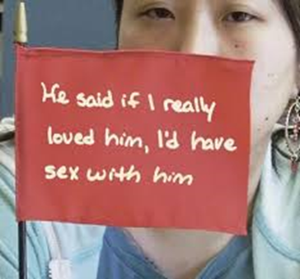
Suggested Alternatives to recording Sexual Exploitation & Abuse ?
X has described sexual activity, however I am concerned that they may have been groomed or coerced into this
X says they are in a relationship with X but I am concerned about the imbalance of power, exploitation and/or offending
X has been/is being groomed, exploited and controlled
X is vulnerable to being sexually exploited
X is being sexually exploited
X said she/he consented to sex but this appeared coerced/pressurised because………

Slide 8
Suggested Alternatives to “Involved in CSE”
“Vulnerable to being sexually exploited” or “they are being sexually exploited”
Stating that the child is involved in CSE implies there is a level of choice regarding the child being abused
A 5 year old would never be referred to as being involved in sexual abuse for the same reasons.

Slide 9
Suggested Alternatives to recording Criminal Exploitation
“Perpetrators/exploiters have a hold over the individual due to their drug dependency”
“Being trafficked for purpose of criminal exploitation”
“Being criminally exploited through drug debt”
“Being groomed through County Lines”

Slide 10
Suggested Alternatives to “Consented to Sex”
YP did say they consented to sex but this appeared coerced/pressurised because………” (state circumstances)
Expand the word consent
Was it Coerced Consent? - groomed, violence & control
Was it Survival Consent? – needed food/YP was locked up/poverty etc
Consent is active, not passive
A child under 13 cannot consent to sex and is therefore being abused. This should be reflected in the language used.

Slide 11
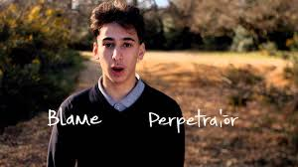
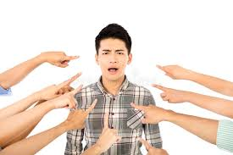
Young People’s Voices
https://www.youtube.com/watch?v=0-R3FVCEN8I

