Slide 1


Your Journey through Care
Let's Listen and Learn Together
WELCOME
Because Safeguarding is everybody’s business
This Photo by Unknown Author is licensed under CC BY-SA

Slide 2

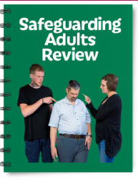
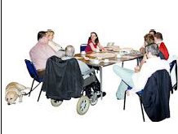
Today
Why we are here
Share information on the Care Act
  Mental Capacity Act
  Best Interest Decisions
What we have learned from Reviews
Hear about your experience
Work together to look at how we might make things better
Because Safeguarding is everybody’s business

Slide 3
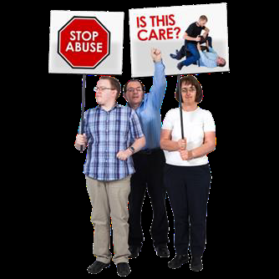

What we will do
We will listen carefully to :
what you tell us about your experiences
The ideas we all have on how to make things better
We will take these back and share with members of our Boards so
They can better understand what it is like for you
Think about what improvements they need to make
Because Safeguarding is everybody’s business

Slide 4

What is a
Safeguarding Adults Board
(SAB)
Made up of people from many agencies:
Worcestershire County Council
West Mercia Police
National Health Services
National Probation Service
Residential Homes
Voluntary Sector
People with lived experience
Because Safeguarding is everybody’s business

Slide 5
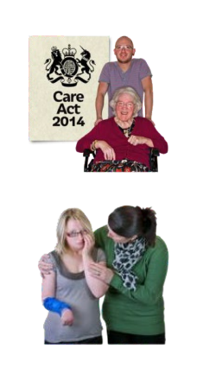
What is a
Safeguarding Adult's Review
(SAR)
Text
The Care Act 2014 makes it the law for a
Safeguarding Adults Review (SAR) to be done when the following things happen:
there is a worry about how agencies worked together to make sure an adult is safe
And the person dies and it could have been because of abuse or neglect
Or the person is alive but they have suffered abuse or neglect
Because Safeguarding is everybody’s business

Slide 6


A Safeguarding Adults review
Looks at how well everyone worked together to keep people safe
helps us learn and know what we could change to make things better in the future
Because Safeguarding is everybody’s business

Slide 7
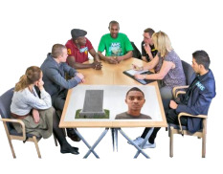
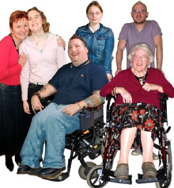
What is the LeDeR
Text
A programme to learn from the lives and deaths of people with a learning disability and autism
Looks at what we can learn to see if we an help health and social care services support people to have better health, happier lives and live longer
Because Safeguarding is everybody’s business

Slide 8

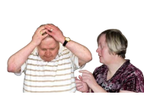
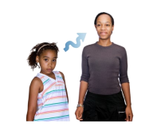
What have we learned from reviews?
Text
Whilst some teams worked well together to plan for peoples best interest, some needed to know more about the Mental Capacity Act and how to make a Best Interest Decision
Especially when peoples lives changed or when a young person moved into adult services
Agencies need to work together more and share information
Because Safeguarding is everybody’s business

Slide 9
The Mental Capacity Act
Text
The Mental Capacity Act is about making decisions. It is a law.
It makes sure people have the support they need to make as many decisions as possible
It also protects people who need family, friends or paid support staff to make decisions for them.
Because Safeguarding is everybody’s business

Slide 10






Its about making BIG and small decisions
Text
What to wear
Whether to let staff help you bath
Whether to let someone look after your money
Where to live
Whether you can stay in a pub for a long time
Whether to go to a doctor
Because Safeguarding is everybody’s business

Slide 11
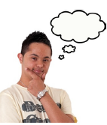


To make a decision we need to be able to
Text
Understand information
Remember it for long enough
Think about the information
Communicate our decision
People's ability to do this can change:
A person with epilepsy may not be able to make a decision during the day after a seizure.
Someone with a mental health problem may not be able to make a decision now, but in a week’s time they may feel much better.
Because Safeguarding is everybody’s business

Slide 12


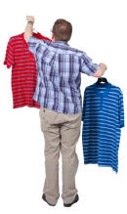
Rules for making a decision
Everyone is different
Text
We should assume that people are able to make decisions, unless it is shown that they are not.
Somebody may not be able to decide whether to move house. They will need people to help them make this decision, or to make this decision for them if they can’t.
But they may be able to decide what to eat and what to wear. They must be allowed to make those decisions.
Because Safeguarding is everybody’s business

Slide 13
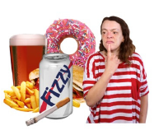

We sometimes make unwise decisions
Text
If a person makes an unwise decision, it is ok, as long as they understand what they are doing
Adults have the right to make decisions other people disagree with. For example
  spending too much on sweets
  Staying a long time in a pub
  Going for a walk in the rain
Because Safeguarding is everybody’s business

Slide 14
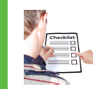
‘Best Interest’
Text
If someone is not able to make a decision, then the people helping them must only make decisions in their ‘best interests’.
Checklist
Can it wait until a time they can make it themselves?
How can the person be helped to make the decision?
What do other people who know the person think?
Because Safeguarding is everybody’s business

Slide 15

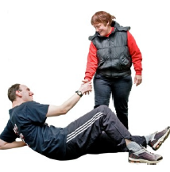
Find the least restrictive way of doing what needs to be done
Text
When a decision is made for somebody, it must give them as much freedom as possible.
For example, a man who likes going outdoors but falls and hurts himself a lot –
Should NOT be kept in,
but should have protective clothes
Because Safeguarding is everybody’s business

Slide 16
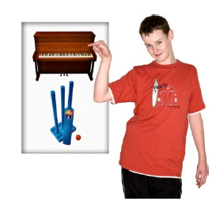
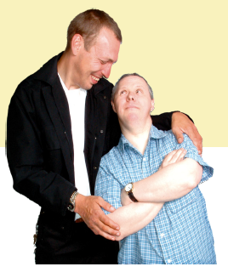
Find out what would the person want?
What have they done in the past
What sort of things do they like, what will make them happy
What don’t they like
Talk to people who know them well
Text
Because Safeguarding is everybody’s business

Slide 17
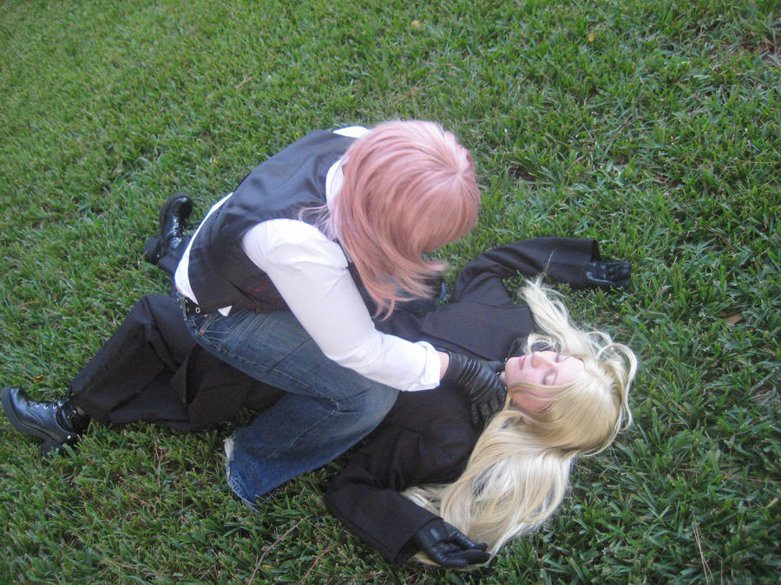
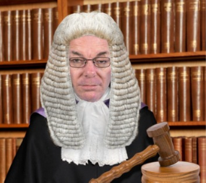

Limits to best Interest
Text
Carers
Must not use restraint
Can not take away a person freedom without legal approval
Must not go against the wishes of someone who is legally allowed to make their own decisions
This Photo by Unknown Author is licensed under CC BY-NC-ND
Because Safeguarding is everybody’s business

Slide 18

What we will do after today
Text
Share what you have told us and the ideas we have had with Health and Social Care providers and our members
Come back and tell you what they are going to do with this
Because Safeguarding is everybody’s business

Slide 19
Morning Workshop
Time to share
Listen and learn
Because Safeguarding is everybody’s business

Slide 20
What have we learned from reviews?
Text
Whilst some teams worked well together to plan for peoples best interest, some needed to know more about the Mental Capacity Act and how to make a Best Interest Decision
Especially when peoples lives changed or when a young person moved into adult services
Agencies need to work together more and share information
Because Safeguarding is everybody’s business

Slide 21


What we know so far
Text
SARs
David
Karen
Joan, Kate and Laura
LeDeR
Miss G
Miss M
Mr S
W
Because Safeguarding is everybody’s business

Slide 22
What you have told us so Far
Text
Because Safeguarding is everybody’s business

Slide 23
What would you like to tell us?
Text
Have had any experience like this that you would like to share?
What happened?
Did anyone help you with this, who and how?
Because Safeguarding is everybody’s business

Slide 24

Lunch
Because Safeguarding is everybody’s business

Slide 25

Afternoon Workshop
What can we change?
Because Safeguarding is everybody’s business

Slide 26
What could we change
Text
What help do you need?
And who can help you with these things?
What’s difficult for you?
How do you like to be supported or
helped?
What make a person easy to talk to ?
Who can help you make difficult decisions ?
Because Safeguarding is everybody’s business

Slide 27
What we will do after today
Text
Share what you have told us and the ideas we have had with Health and Social Care providers and our members
Come back and tell you what they are going to do with this
Because Safeguarding is everybody’s business

Slide 28

Because Safeguarding is everybody’s business

Slide 29

Because Safeguarding is everybody’s business

