Slide 1
Call Blocker Project 2023

Slide 3
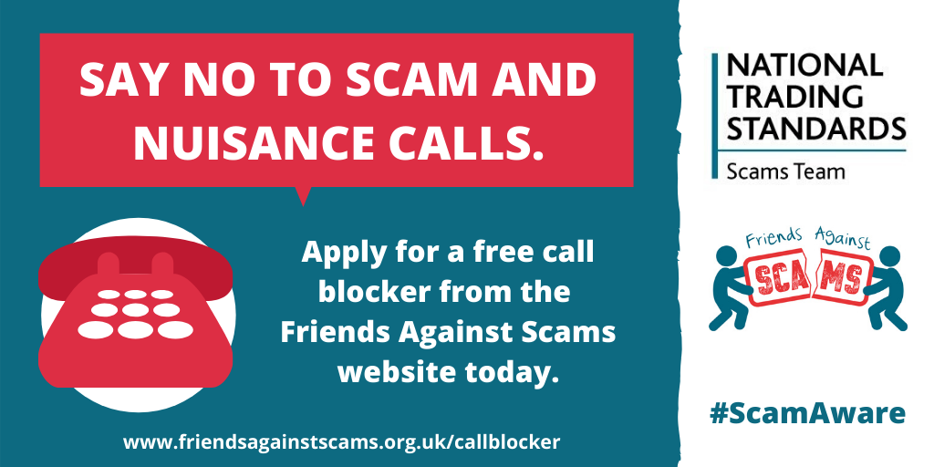

Slide 4
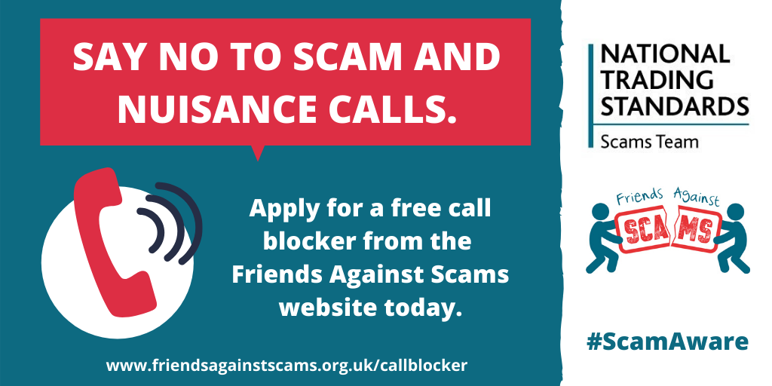

Slide 5
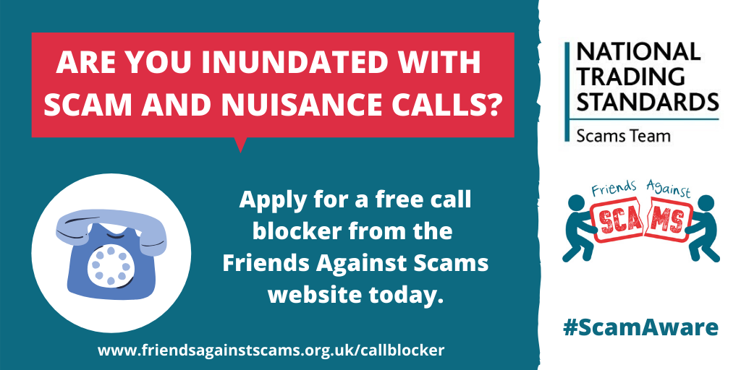

Slide 6
🚫 Tired of scam calls ringing your landline? 📞 @FriendsAgainst are giving away FREE call blocker units but act fast – they're flying off the shelves! ⏳
Don't let your loved ones fall victim to scam and nuisance calls. Point them in the right direction! 🦸‍♂️🦸‍♀️ Visit www.friendsagainstscams.org.uk/callblocker to grab one of these units today! 💪
Let's put an end to scam calls together. Spread the word and protect your community! 🛡️💬 #ScamAware #CallBlocker

Slide 7
📞🚫 Fed up with those relentless scam calls on your landline? Worried about losing your hard-earned cash? @FriendsAgainst can help! 💰
Take control and say goodbye to nuisance calls! 🙅‍♂️🙅‍♀️
Grab your FREE call blocker today or help your friends and family by sharing this link: www.friendsagainstscams.org.uk/callblocker 🦸‍♂️🦸‍♀️
Protect your money and your peace of mind. Join the fight against scams now! 🛡️💪 #ScamAware #CallBlocker

Slide 8
🚨 Protect Your Loved Ones! 🚫 scam callers beware! 💪
“Mum was very frightened before. It's been such a fantastic thing.”
If you've got friends or family who could use some extra peace of mind, don't wait! Help them take control and apply for a FREE call blocker. 📵 Together, we can silence the criminals! 💥
Visit 👉 www.friendsagainstscams.org.uk/callblocker 👈 to get started today!
Let's unite against scams! 🤝💔
#ScamAware #CallBlocker

Slide 9
Not everybody uses social media, so those who can benefit most from a call blocker might not see this campaign offering free units.
If you have friends, family, or neighbours who receive scam and nuisance calls and would benefit from a call blocker on their landline, send them this link to apply online: www.friendsagainstscams.org.uk/callblocker
#ScamAware #CallBlocker

Slide 10
Do you want more confidence in answering your landline? In partnership with trueCall, the National Trading Standards Scams Team are offering free call blocking technology to those receiving scam and nuisance calls.
Be #ScamAware and apply for a #CallBlocker today at: www.friendsagainstscams.org.uk/callblocker

Slide 11
🚫 Tired of scam calls ringing your landline? 📞 @AgainstScams team is giving away FREE call blocker units but act fast – they're flying off the shelves! ⏳
Visit www.friendsagainstscams.org.uk/callblocker to grab one of these units today! 💪
Spread the word!! 🛡️💬 #ScamAware #CallBlocker

Slide 12
📞🚫 Fed up with those relentless scam calls on your landline? @AgainstScams can help! 💰
Don't let those criminals get the upper hand. Take control and say goodbye to scam calls! 🙅‍♂️🙅‍♀️
Grab your FREE call blocker today: www.friendsagainstscams.org.uk/callblocker 🦸‍♂️🦸‍♀️
🛡️💪 #ScamAware #CallBlocker

Slide 13
🚨 Protect Your Loved Ones from scam callers
“Mum was very frightened before. It's been such a fantastic thing.”
Help your friends and family take control and apply for a FREE call blocker. 📵
Visit 👉www.friendsagainstscams.org.uk/callblocker 👈
#ScamAware #CallBlocker

Slide 14
“It's the best thing we've ever done! We've had no scam calls through at all.”
Are you worried about scam and nuisance calls?
Be #ScamAware and apply for a #CallBlocker today at: www.friendsagainstscams.org.uk/callblocker

Slide 15
“I now have a tool to fight back. To be honest, it’s brilliant.” - A recipient of the trueCall unit.
Check if you are eligible for a free call blocker at:
www.friendsagainstscams.org.uk/callblocker
#ScamAware #CallBlocker

