Slide 1


Caring for the Carers
Let's Listen and Learn Together
WELCOME
Because Safeguarding is everybody’s business
This Photo by Unknown Author is licensed under CC BY-SA

Slide 2
Today
Share information on the Care Act
What we have learned from Safeguarding Adults Reviews in relation to Carers
Hear about your experience
Build up our knowledge and look at what support and information is already available.
Identify any opportunities and approaches for improvements
Because Safeguarding is everybody’s business

Slide 3
Safeguarding Adults Boards
Statutory Partnership (Care Act 2014)
Worcestershire County Council
West Mercia Police
Integrated Care Board
Health NHS services
National Probation Service
Residential Homes
Voluntary Sector
People with lived experience
  Carers
  Advocates
  People
Because Safeguarding is everybody’s business

Slide 4
What is a
Safeguarding Adult's Review
(SAR)
The Care Act 2014 makes it the law for a
Safeguarding Adults Review (SAR) to be done when the following things happen:
there is a worry about how agencies worked together to make sure an adult is safe
And the person dies and it could have been because of abuse or neglect
Or the person is alive but they have suffered abuse or neglect
Because Safeguarding is everybody’s business

Slide 5
A Safeguarding Adults review
Looks at how agencies worked together
Identifies learning and makes recommendations for improvements
Because Safeguarding is everybody’s business

Slide 6
Key Themes in relation to Carers
Language
  Dorothy SAR
Listening to Carers
  Jane SAR
Application of Legal Frameworks (particularly at transition)
  Lucy SAR
  Mary SAR
  Jane Kate and Laura
Training and Support
  Lucy SAR
Because Safeguarding is everybody’s business

Slide 7
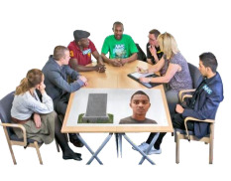
Training and Support
Because Safeguarding is everybody’s business

Slide 8
Training and Support for Carers
Lucy was a 19-year-old woman who had complex needs from birth which required 24 hour care. She tragically died at home following an accident with her equipment.
Learning from this review included:
The importance of starting transition planning for young people starts as early as possible
Ensuring that the Mental Capacity Act is applied when young people are moving from children to adult services.
professionals to satisfy themselves that family carers have the capacity and the support (training) necessary for them to provide safe care to adults with complex needs within the family home
Because Safeguarding is everybody’s business

Slide 9

Sharing your Experience
Group Exercise
What are the barriers and challenges?
What is the impact does this have on you as a carer?
(What impact can this have on carers?)
What might be the solutions?
Because Safeguarding is everybody’s business

Slide 10




Company Overview
Products Services & Team Culture
Accomplishments & Recognition
Future Plans
Technology-Enabled Care Services (TECS) encompass a range of technologies designed to support and enhance the delivery of health and social care. Our approach is that there is not a one-size-fits-all solution, but one of providing a personalised tailored approach to suit the need.
TECS not only supports the individual but also greatly enables carers and improves the quality of human care.
TECS is NOT just for older persons.
TECS isn't just a pendant alarm pressed if they have a fall.
We have technologies to help with a wide range of conditions such as:
- Dementia
- Learning difficulties
- Mobility
- Epilepsy
- Parkinson's
- Falls
- Hearing Impairment
- Strokes
- Anxiety
- Visually impaired

Slide 11

Company Overview
Products Services & Team Culture
Accomplishments & Recognition
Future Plans
The main objectives of these services include:
Improving Access to Care:
Remote Monitoring: Enable healthcare and carers to monitor individuals’ health and daily activities remotely, allowing for early detection of issues and timely interventions.
24/7 Monitoring and Response. NOT JUST FOR FALLS.
Enhancing Independence:
Assistive Technologies: Provide tools and devices that support individuals in managing their health conditions and daily activities independently.
Telecare Services: Offer solutions such as alarms and sensors that enable people, especially the elderly or those with chronic conditions, to live at home safely.
Promoting Self-Management:
Health Apps and Wearables: Empower individuals to track and manage their health through mobile applications and wearable devices, promoting a proactive approach to well-being.

Slide 12
Company Overview
Products Services & Team Culture
Accomplishments & Recognition
Future Plans
Personalised and Person-Centred Care:
Data Analytics: Utilise health data to tailor care plans to individual needs, providing more personalised and effective treatments.
Patient Engagement: Foster active participation in healthcare decisions by involving patients in their care plans and providing educational resources.
Improving Quality of Care:
Decision Support Systems: Assist healthcare professionals with evidence-based information and decision-making tools, leading to improved diagnostic accuracy and treatment outcomes.
https://www.communityhousingtecs.co.uk/customer-stories/emily.php
www.communityhousingtecs.co.uk

Slide 13

WWW.CARERSWORCS.ORG.UK
INDEPENDENT ADVICE & INFORMATION FOR CARERS
WORCESTERSHIRE CARERS HUB

Slide 14

Assistive Technology Solutions
Assistive Technology provides ways to adapt the home of the person you care for , with many different solutions for different needs, allowing people to live and remain independent, safe, giving you a peace of mind and a much-needed break.
INDEPENDENT ADVICE & INFORMATION FOR CARERS
WORCESTER﻿SHIRE CARERS HUB

Slide 15

Assistive Technology Solutions
Ways that’s technology may support you and the person you care for
Maximise Independence of loved one
Supports getting a meaningful break
Supports working Carers
Supports managing Risks – DOL, Self neglect, relationship breakdown
Supports management of medication/track health indicators
Reduce unplanned hospital admissions
INDEPENDENT ADVICE & INFORMATION FOR CARERS
WORCESTER﻿SHIRE CARERS HUB

Slide 16

Language
This Photo by Unknown Author is licensed under CC BY-SA
Because Safeguarding is everybody’s business

Slide 17

Language and Labels
True Story - The real impact of our language and labels
Because Safeguarding is everybody’s business

Slide 18
Language and Labels
Labels are how we identify things. We use them descriptively and to group like items
What labels do you have?
Are they helpful or unhelpful
Do they limit you?
Do they create an accurate judgement about you?
Avoid the use of generic labels such as ‘challenging behaviour’ when looking for placements
Because Safeguarding is everybody’s business
Notes:
Good cook, always late, shy, confident, weak, miserable, boring

Slide 19
Language
Dorothy
Dorothy died following an assault by another resident in a Care Home. Concerns were raised regarding the suitability of the Care Home to manage the behaviour of the man who assaulted her.
Learning Recommendation:
Avoid the use of generic labels such as ‘challenging behaviour’ when looking for placements
Because Safeguarding is everybody’s business

Slide 20
Sharing your Experience
What terms do you use/hear regularly?
What do we know about labels and generic descriptive terms?
can set the tone for the whole conversation – once someone is labelled it is hard to lose that label.
Challenging behaviour – used as a term to catch all. What/who is being challenged? Don’t we all have challenging behaviour? Having difficult conversations with the Care places
Why don’t we say challenging communication? After all, behaviour is a communication method!
Activity - What are the negative terms you would like to be avoided? Think of a positive alternative
  word ‘storm’ cloud – and positive word ‘rainbow’ cloud
Because Safeguarding is everybody’s business
Notes:
– physical communication- what are they trying to say – how can we work with them – about good care plans/asset-based approach.

Slide 21


Negative
Positive

Slide 22
Challenge and Test labels
By becoming aware of labels, we can start to reduce their power and impact. Challenge and test labels and generic terms against reality.
Question labels and judgmental terms by asking:
Is this label currently true?
Was this label ever true?
Who told me this?
Is this label actually negative? Or was I told it was negative?
Is this label serving or harming the person?
Who would the person be without this label?
Labels don’t have to define a person.
Because Safeguarding is everybody’s business

Slide 23



BREAK
Because Safeguarding is everybody’s business

Slide 24

Listening to Carers
This Photo by Unknown Author is licensed under CC BY-NC
Because Safeguarding is everybody’s business

Slide 25
Experts by Experience
A carers perspective
Jane
47 years old when died in hospital from heart disease linked to high blood pressure, infected leg ulcers with septicemia and liver disease.
Been supported by Mental Health Services, and lived with mother since her 20’s.
Person cantered care should include understanding the balance between what the individual wants and what the carer thinks they need
Understanding the culture and dynamics of a family.
Because Safeguarding is everybody’s business

Slide 26
Sharing your Experience
Understanding how the family/carers encourage or reinforce behaviour
Recognising that this can be more challenging when had some independence.
Addressing the stigma of a safeguarding referral –‘impact on carer even when no evidence found
Does this have any resonance with you?
Are there other areas where professional could listen more to carers?
What and how could we listen more?
Because Safeguarding is everybody’s business

Slide 27

Legal Frameworks
Because Safeguarding is everybody’s business

Slide 28
Application of Legal Frameworks Transition and Best Interest
  Lucy SAR
    Residential accommodation then moved home
  Mary SAR
    Complex needs found to be pregnant
    Number of opportunity
  Jane Kate and Laura
    One child with learning disability
    Questions regard mothers mental health/undiagnosed learning disabilty
    Neglect in family home
    Financial questions regarding use of money to support daughter
Because Safeguarding is everybody’s business

Slide 29
The Mental Capacity Act
requirements when an individual lacks
the mental capacity to consent to
treatment and care
WSAB – National Safeguarding Week
Carers and their Wellbeing
Professor Keith Brown
22nd November 2023

Slide 31
Demystifying Mental Capacity
Set against the backdrop of the Mental Capacity Act 2005, this book explores and addresses issues raised by mental capacity within adult safeguarding, and provides clear guidance on the use and value of the MCA, and how to ensure that the rights and choices of individuals are heard, listened to and acted upon.
With contributions from a range of subject experts across the legal, social work, nursing and healthcare disciplines, this book will be invaluable to practitioners in the health and social care profession, and indeed any role where issues of mental capacity may be a concern. Case studies, reflection points and exercise are used to develop understanding and support critical engagement with practice.

Slide 35

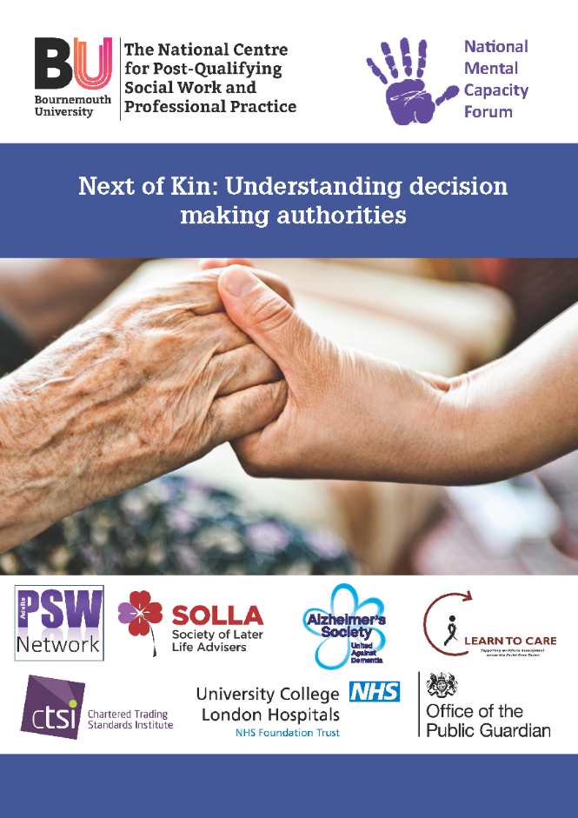
Resources freely available

Slide 39
Best Interest Checklist continued

Slide 40

Because Safeguarding is everybody’s business

Slide 41

Wellbeing
Because Safeguarding is everybody’s business

Slide 42
Next Steps
Feedback to Board
Look at areas we can improve
Because Safeguarding is everybody’s business

Slide 43

Because Safeguarding is everybody’s business

