Slide 1

Complex Adult Risk Management (CARM)
Sue Lawrence
CARM Project Lead
Because Safeguarding is everybody’s business

Slide 2
Referrals: A total of 125 referrals have been made to CARM since May 2022, 77 of these progressed to a CARM. During 2023/24 there were a total of 81 referrals to CARM. The CARM framework is currently being used with 52 adults within Worcestershire. A total of 25 CARM referrals have been closed following intervention / alternative actions being taken since May 2022.
Because Safeguarding is everybody’s business
Notes:
Correct at end on March 2024. There is evidence over the last 3 months that appropriate referrals are being made to CARM. Five referrals were made in October with four being appropriate to use the CARM framework. Eight referrals were made in November all of which progressed to CARM.

Slide 3
What’s working well:
Agencies are identifying adults that would be appropriate for CARM.
Adults are being supported through joined up working.
Improved networking and engagement of organisations best placed to provide support to the person
Evictions have been delayed whilst further work is progressed thereby reducing potential homelessness / further mental health breakdown.
Alternative ways of working are identified rather than fixed procedures eg early/late appts to reduce anxiety / trigger points.
Because Safeguarding is everybody’s business

Slide 4
What’s working well:
Risk is agreed and shared between agencies.
Practitioners are using CARM as part of their toolkit of response to complex cases.
Information gathering for DHR35/SAR has identified that agencies were communicating and there was a Lead Practitioner in place due to the CARM framework.
Reduction in ‘revolving’ door referrals.
Continuity and consistency for adults.
Because Safeguarding is everybody’s business

Slide 5
What needs improving:
Confidence when chairing meetings.
Overall risk assessment within safety plan.
Understanding of escalation process
Actions required when risk is assessed as high / extreme risk.
Same use of language when referring to risk.
Use of risk tool that uses narrative recording.
Because Safeguarding is everybody’s business

Slide 6
Current Process:
Agency identifies adult suitable for CARM.
Referral is completed and sent to CARM email.
CARM Project Lead reviews and advises on how to progress / agencies to include.
Referring agency chairs first CARM meeting.
Safety Plan is completed.
Lead Practitioner is agreed at the meeting.
Because Safeguarding is everybody’s business

Slide 7
Lead Practitioner:
Referring agency arranges first CARM meeting.
At this meeting the Lead Practitioner is agreed.
The role of the Lead Practitioner is to:
  Arrange review of safety plan as required.
  Ensure actions are completed.
  Chair review meetings
  Escalate risk
  Escalate concerns re: agencies lack of engagement.
Because Safeguarding is everybody’s business

Slide 8
Lead Practitioner:
Currently the Lead Practitioner is generally a frontline worker.
What needs improving:
Confidence when chairing meetings.
Should a Supervisor / Team Leader / Manager chair the CARM meeting and the Lead Practitioner attend as a frontline worker involved with the adult?
Because Safeguarding is everybody’s business

Slide 9
What needs improving:
Use of risk tool that uses narrative recording.
  CARM Risk Matrix developed
Overall risk assessment within safety plan.
  New Safety Plan created with risk embedded
Actions required when risk is assessed as high / extreme risk.
  Oversight required will be explicit within the plan.
Same use of language when referring to risk.
  Language within s42 / self-neglect procedures to be reviewed.
Because Safeguarding is everybody’s business

Slide 10
Risk Matrix for level of risk & oversight needed:
Assessment Term | Threat | Vulnerability | Impact | Level of Oversight Required (Governance Agreement)
Negligible | There is no history of this kind of event | Robust and extensive interventions or protections are in permanently in place. | No noticeable damage. loss or injury likely.
Low | This kind of event has occurred in the past but not regularly or for some time. | Robust and extensive interventions or protections are in place on most occasions. | No harm to the individual or others physically or emotionally.
Moderate | This type of event happens multiple times per year. | Limited interventions or protections are in place on most occasions. | Injury to self / others that requires 1st aid. Anxiety to self or others / tension in relationships. Moderate damage to own or others property. | Risk to remain shared with Multi-agency professional. Supervisors / Team Leader to be advised of CARM safety plan
Because Safeguarding is everybody’s business

Slide 11
Risk Matrix for level of risk & oversight needed:
High | This type of event happens multiple times per month. | Limited interventions or protections are available occasionally. | Injuries to self / others that require hospital treatment. Acute emotional trauma to self or others / relationships damaged. Significant damage to own or others property. | Risk to be escalated to agency Safeguarding Lead for each agency involved with the CARM for this adult.
Extreme | This type of event happens multiple times per week | No interventions or protections are in place. | Life threatening injury to individual / others. Persistent emotional trauma to self or others / relationships irreparably damaged. Significant damage to own or others property which places risk to their own or others lives. | Risk to be escalated to Worcestershire Safeguarding Adult Board by agency Safeguarding Leads.
Because Safeguarding is everybody’s business

Slide 12
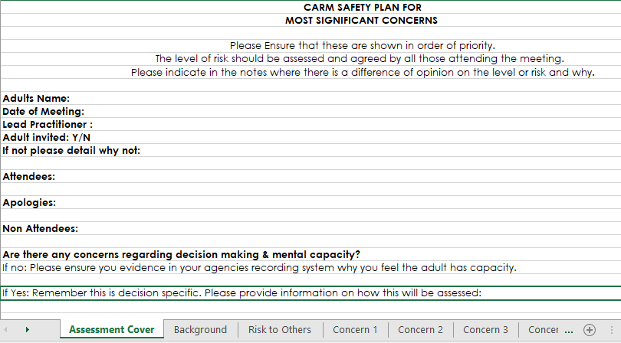
Risk Matrix for level of risk & oversight needed:
Because Safeguarding is everybody’s business

Slide 13
Developing a safety plan with risk matrix embedded:
 | What are we (agencies and / or the person) worried about?
 | What is working well
 | If this happened, what would be the impact on the person? | Rating | Contributing factors
 | Threat | Moderate
 | Impact | High
 | Vulnerability | Low
 | Concern 1 overall evaluation | Moderate
Because Safeguarding is everybody’s business

Slide 14
Future – 2025 Onwards
CARM Project Lead role to end March 2025
Need to consider:
No point of contact for referral.
Data collation?
How are risks monitored?
Understanding of overall risk?
Will risks be escalated appropriately?
How do other areas manage CARM, MARM, VARM?
Add to WSAB / WCC Risk Register?
Because Safeguarding is everybody’s business

Slide 15
Suggestions / Ideas:
How should we oversee CARM cases from 2025?
Who should chair CARM meetings?
How can data be collected?
Because Safeguarding is everybody’s business

