Slide 1


Worcestershire Safeguarding Adults Board
Network Meeting
22nd May 2024
Because Safeguarding is everybody’s business
This Photo by Unknown Author is licensed under CC BY-SA

Slide 2
Why are we here
REFLECT
and
LEARN
Respect Each others' views and positions
Because Safeguarding is everybody’s business

Slide 3
AGENDA
10:00 | Welcome and Introductions
10:15 | DWP – Accessing Universal Credit (issue identified in Thematic Review on Rough Sleeping)
11:15 | Break
11:30 | CARM Update
12: 00 | SARs
12:10 | Second National SAR analysis
12:20 | Actions from last time and Future agenda items
Because Safeguarding is everybody’s business
Notes:
What is it that makes us keep doing what we do ?

Slide 4
Guest Presentation
Toby Wells
Department of Work and Pensions
Partnership Support Manager
Shropshire, Telford & Wrekin, Hereford & Worcester
Because Safeguarding is everybody’s business
Notes:
What is it that makes us keep doing what we do ?

Slide 5



BREAK
Because Safeguarding is everybody’s business

Slide 6
Complex Adult Risk Management
Update
Sue Lawrence
CARM Project Lead
WSAB
Because Safeguarding is everybody’s business
Notes:
What is it that makes us keep doing what we do ?

Slide 7
Safeguarding Reviews
Published since last meeting
John (published January 2024)
54 year old white male
history of alcohol, substance misuse, also
suspected suicidal incidents following the loss of his family network.
He had previously slept rough, but not at the time of his death.
Rapid Review SAR Report – John
Learning Briefing for professionals – John
Because Safeguarding is everybody’s business
Notes:
What is it that makes us keep doing what we do ?

Slide 8
John
Learning from this review included:
  Self-Neglect is complex and requires a Multi-agency approach – should refer to Self-Neglect Policy & CARM Framework
  Making Safeguarding Personal (MSP) – Exploring methods of preferred contact
  Managing Risk – Multi-agency approach
Because Safeguarding is everybody’s business
Notes:
What is it that makes us keep doing what we do ?

Slide 9
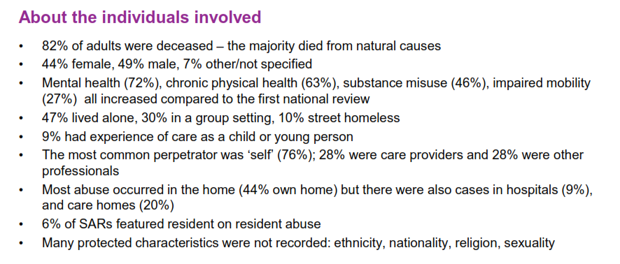
2nd National SAR analysis
Because Safeguarding is everybody’s business
Notes:
What is it that makes us keep doing what we do ?

Slide 10
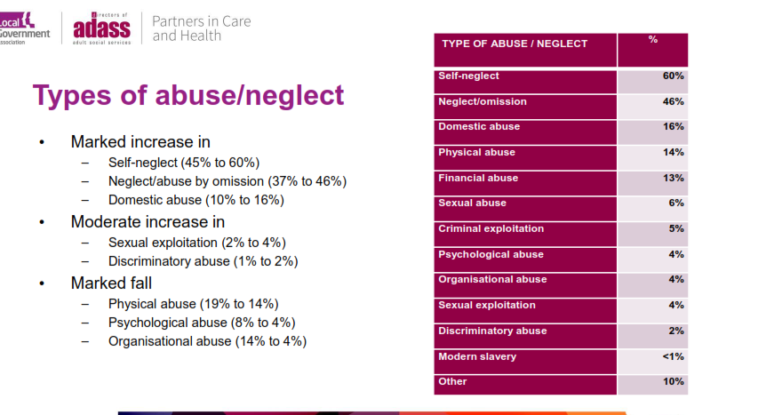
2nd National SAR analysis
Because Safeguarding is everybody’s business
Notes:
What is it that makes us keep doing what we do ?

Slide 11
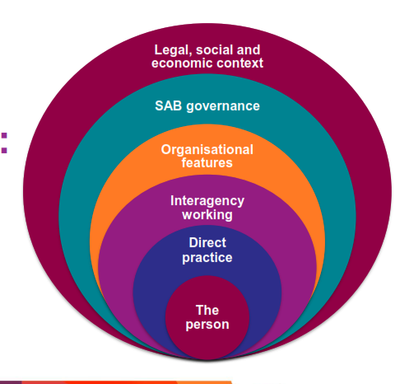
2nd National SAR analysis
Domains
Because Safeguarding is everybody’s business
Notes:
What is it that makes us keep doing what we do ?

Slide 12
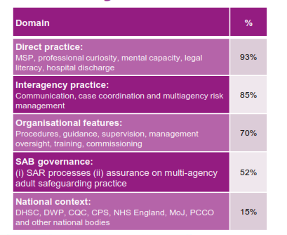
2nd National SAR analysis
Because Safeguarding is everybody’s business
Notes:
What is it that makes us keep doing what we do ?

Slide 13
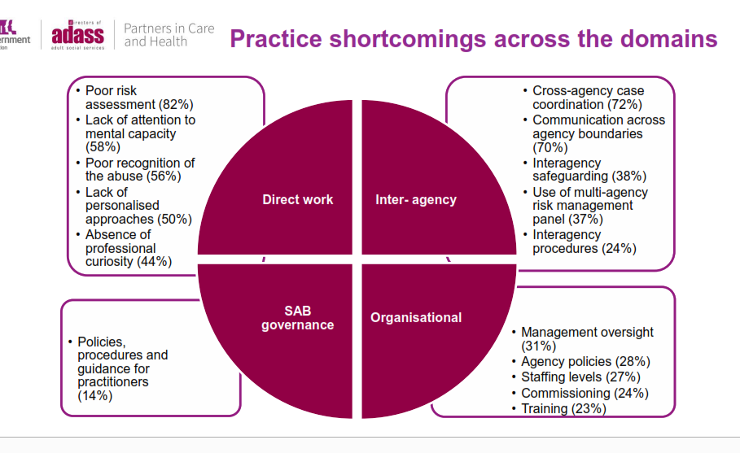
2nd National SAR analysis
Because Safeguarding is everybody’s business
Notes:
What is it that makes us keep doing what we do ?

Slide 14
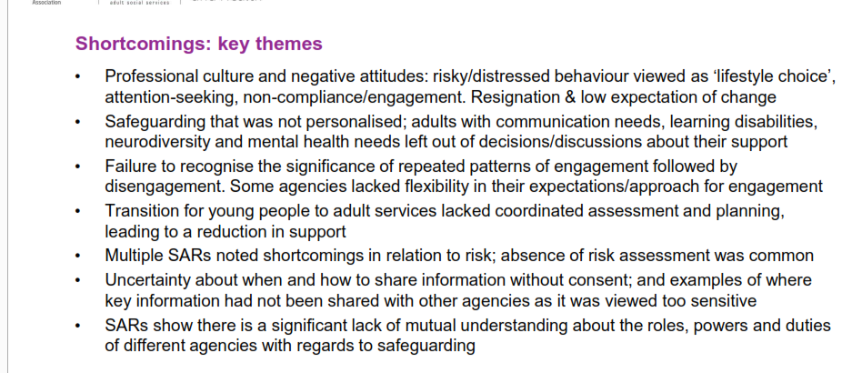
2nd National SAR analysis
Because Safeguarding is everybody’s business
Notes:
What is it that makes us keep doing what we do ?

Slide 15
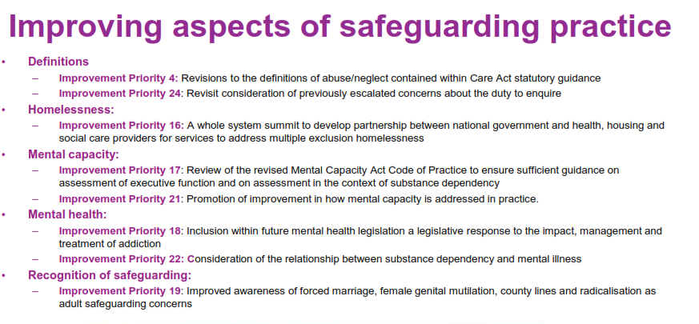
2nd National SAR analysis
Because Safeguarding is everybody’s business
Notes:
What is it that makes us keep doing what we do ?

Slide 16
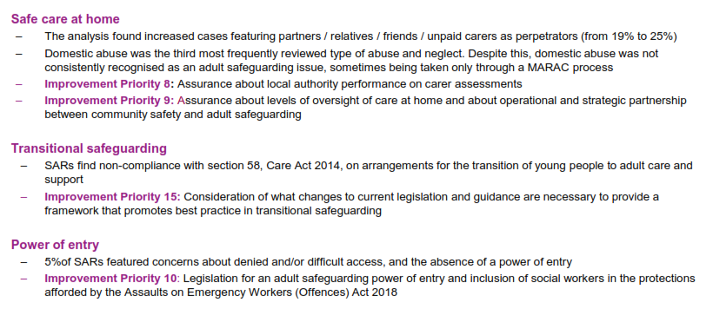
2nd National SAR analysis
Because Safeguarding is everybody’s business
Notes:
What is it that makes us keep doing what we do ?

Slide 17
2nd National SAR analysis
  Processes
  Findings
Because Safeguarding is everybody’s business
Notes:
What is it that makes us keep doing what we do ?

Slide 18
2nd National SAR analysis
What next?
Look at recommendations
Findings/Practice
Consider finding and as ‘is it happening here’?
Direct Practice
Interagency working
Look at how they can strengthen way they seek assurance around effectiveness of
policies and procedures,
outcomes of training,
provision of supervision and management oversight
Because Safeguarding is everybody’s business
Notes:
What is it that makes us keep doing what we do ?

Slide 19
WSAB Business Priorities
2024/25
Implement the Learning Framework to ensure that SAR learning is embedded in practice and is underpinned by clear a communication plan which includes the sharing of good news and practice. Areas of focus should include:
    professional curiosity
    Safeguarding rights
Continue to build links with other partnership to support the delivery of shared objectives including:
  implementation of the Exploitation Strategy with the CSPs and/or SCP
  developing a shared approach to implementing the recommendations of Domestic Homicide Reviews with the Domestic Abuse Partnership
  Working with the Children’s Partnership and Herefordshire SAB in establishing a robust assurance approach for reviewing the organisational assessments submitted through the regional assurance tool.
Implement the new actions identified in the Quality Assurance Framework, in particular:
    Reviewing the themes identified by organisations through the regional assurance tool
Because Safeguarding is everybody’s business
Notes:
What is it that makes us keep doing what we do ?

Slide 20
Actions | Status
If anyone has work they are proud of and happy to share with the Board we will look at publishing in Annual Report | (need by end of April)
Exploitation Strategy - revisit the PREPARE assessment tool. Include older people and forward to the network for further comments/suggestions | In Progress (
BH to check CID is correct on PURSUE pathway – thinks this could be SMT.
Because Safeguarding is everybody’s business
Notes:
What is it that makes us keep doing what we do ?

Slide 21
Future Meeting Items
Mental Capacity Act -Pathway
CQC LA Inspection – how it will impact services – (Next meeting November)
Transitional safeguarding
Oliver McGowan training – access to training is difficult for some
Information on Audit of MCA application / best interest decisions/advocacy (still in progress)
Providers to share good practice and Initiatives
Update on Thematic Review
Anything from today
Because Safeguarding is everybody’s business
Notes:
What is it that makes us keep doing what we do ?

Slide 22
Any Other Business
Training Level 4 (Maggs)
Because Safeguarding is everybody’s business
Notes:
What is it that makes us keep doing what we do ?

Slide 24

Close and Network
Thank you
Because Safeguarding is everybody’s business
Notes:
What is it that makes us keep doing what we do ?

